Slide 1

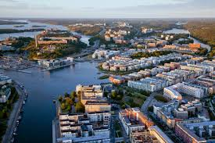
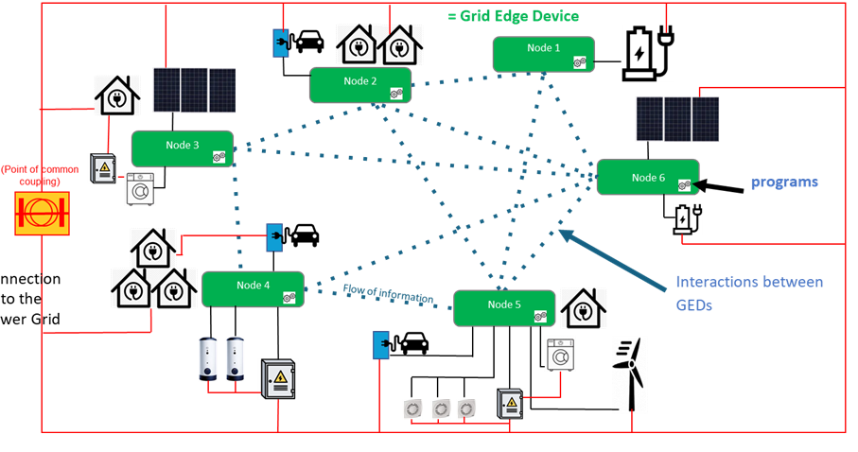

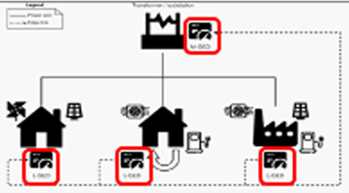
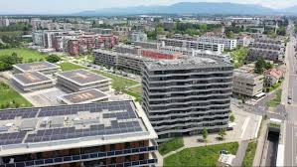
Coordination model and digital twins for managing energy consumption and production in a smart grid.
PhD Dissertation, June 20th, 2025
Philippe Glass
PhD Information Systems
Supervised by Prof. Giovanna Di Marzo Serugendo
In gratitude to the members of the jury:
Prof. Jean-Henry Morin (president)
Prof. Jose Luis Fernandez-Marquez
Prof. Davide Calvaresi
Prof. Emmanuel Fragnière
Prof. Giovanna Di Marzo Serugendo

Slide 2

Agenda
Context and motivations
State of the art and research questions
Coordination Model and Digital Twins
Exchange and regulation of energy among Digital Twins
Gossip coordination mechanism for decentralised learning
Integration of Social acceptance
Conclusion
PhD dissertation, June 2025

Slide 3








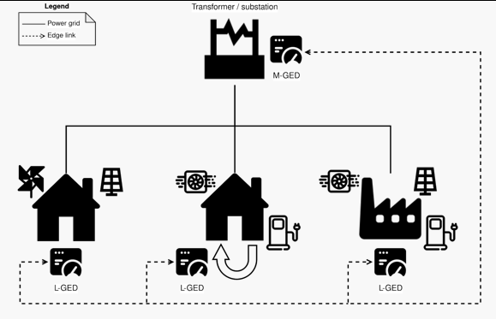



Context : Lasagne project
“
ERA-NET
(European
Research Area)
Genève
Advisory Board
Valais
research & development
research & development
UNIGE
-+++
deployments
PhD dissertation, June 2025

Slide 4
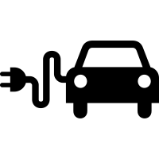






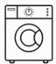
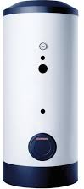


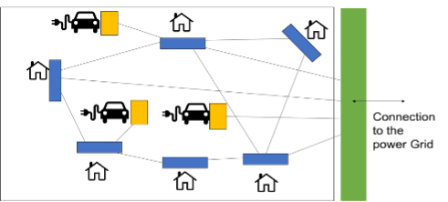
Context : Grid Edge Devices
= Grid Edge Device
Node 1
Node 2
Node 3
(Point of common coupling)
Node 6
programs
Connection
to the
Power Grid
Node 4
Flow of information
Interactions between nodes
Node 5
Flow of electricity
PhD dissertation, June 2025

Slide 5

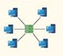
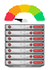
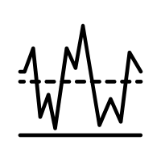

Motivations
Microgrid node computing units are not able to exchange energy in an autonomous and decentralised way.
Centralised systems cannot manage microgrid entities, which provide huge quantities of electricity data generated in different places and at different times.
Difficulty to manage renewable energies whose production is particularly fluctuating in time.
Social dimension not considered in smart-grids
(role of prosumer, equity, environmental protection, user's profiles and preferences).
PhD dissertation, June 2025

Slide 6
Agenda
Context and motivations
State of the art and research questions
Coordination Model and Digital Twins
Exchange and regulation of energy among Digital Twins
Gossip coordination mechanism for decentralised learning
Integration of Social acceptance
Conclusion
PhD dissertation, June 2025

Slide 7

State of the art
Intelligent agents and Digital Twins:
[Hussein Marah et al. “Intelligent agents and multi agent systems for modeling smart digital twins in: Engineering multi-agent systems (2022).”
Sapere model:
(inspired by biology & chemistry)
[Castelli, Gabriella et al. “Engineering pervasive service ecosystems: the Sapere approach” (2015)]
Coordination models
Multi-agent
systems
Machine learning
Contributions:
Coordination model and DT for managing energy consumption and production in a smart grid
Distributed Federated Learning:
[Wei Liu, Li Chen, and Wenyi Zhang: “Decentralized Federated Learning: Balancing Communication and Computing Costs” 2022]
PhD dissertation, June 2025

Slide 8

Research questions
RQ1. Can we design a coordination model and mechanisms that allows Grid Edge Devices to collectively achieve various objectives?
RQ2. How can we model the notion of digital twins to represent micro-grid entities which exchange and regulate energy at a local level?
RQ3. How can we integrate into a coordination model a gossip mechanism than can be used for decentralised learning, with an aggregator that the client layer can define on the fly?
RQ4. To what extent can we integrate criteria of social acceptability into Digital Twins behaviours, in decision-making processes for electricity transaction and electricity regulation?
RQ5. Can we implement a light version of the coordination model that can run on a Grid Edge Device with a small amount of disk space and memory?
PhD dissertation, June 2025

Slide 9
Agenda
Context and motivations
State of the art and research questions
Coordination Model and Digital Twins
Design of a coordination model
Design of Digital Twins to represent microgrid entities
Architecture and implementation
Exchange and regulation of energy among Digital Twins
Gossip coordination mechanism for decentralised learning
Integration of Social acceptance
Conclusion
PhD dissertation, June 2025

Slide 10
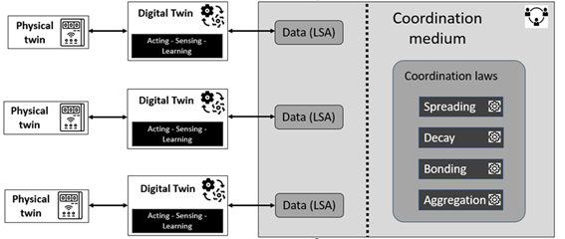
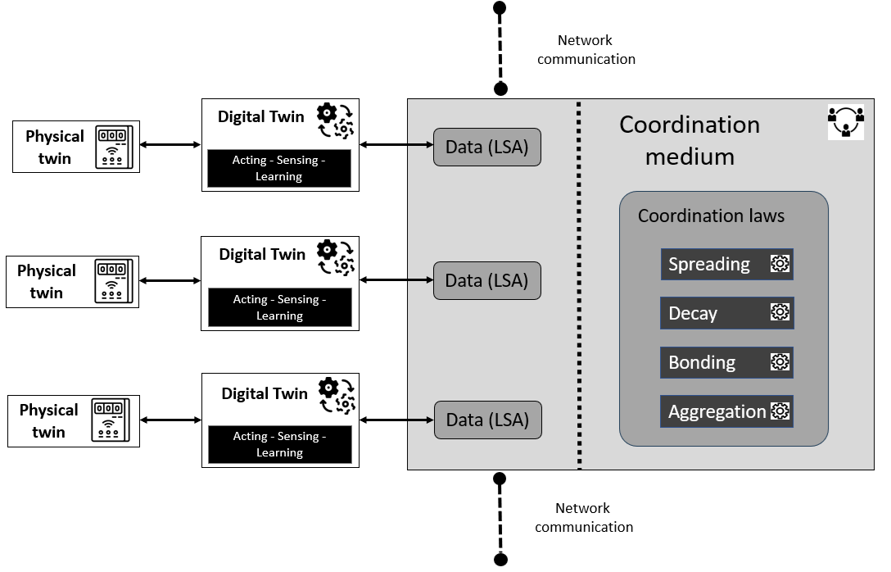
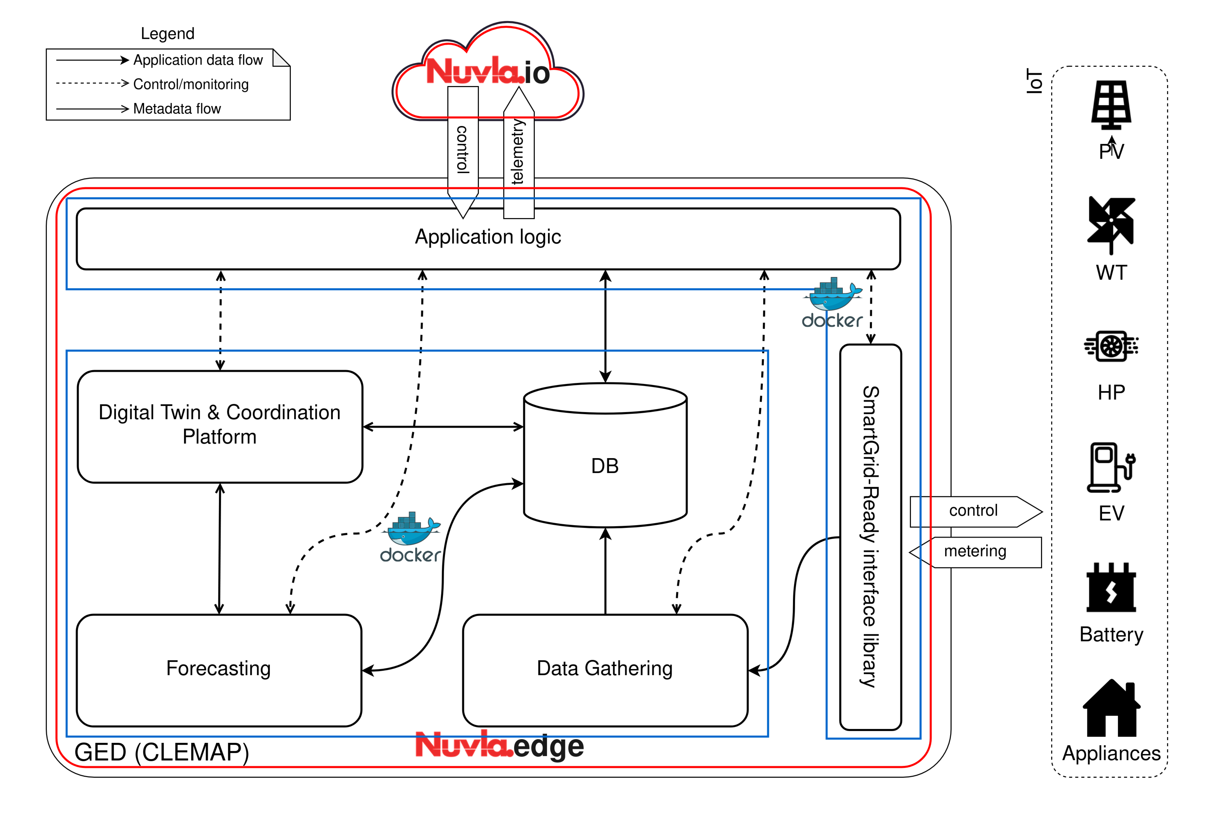
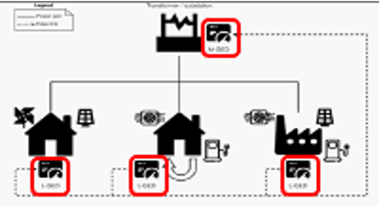
Design of a coordination model
Definition: Coordination model composed with :
the coordination medium (= tuple space)
the coordination laws
PhD dissertation, June 2025

Slide 11
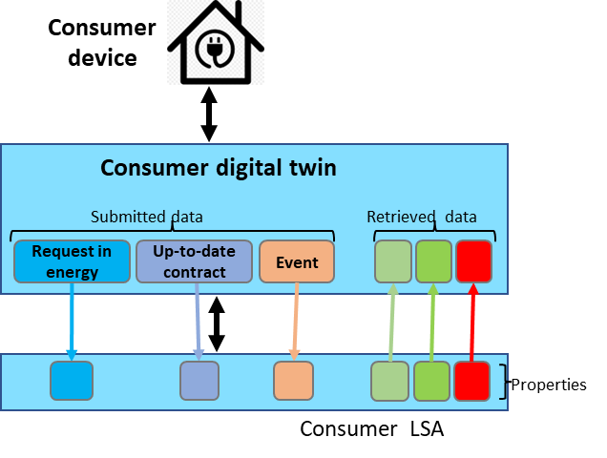
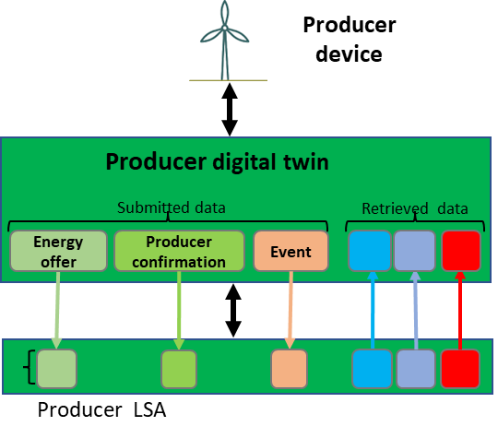
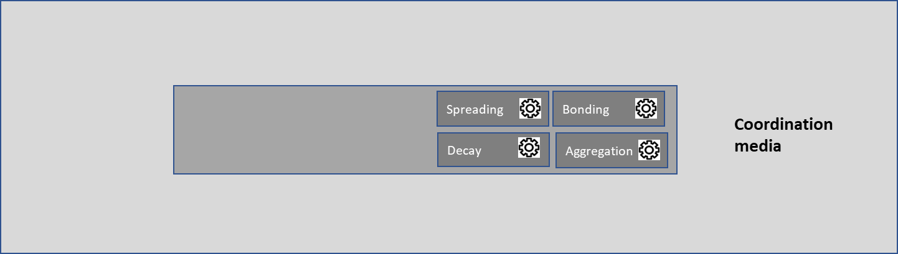
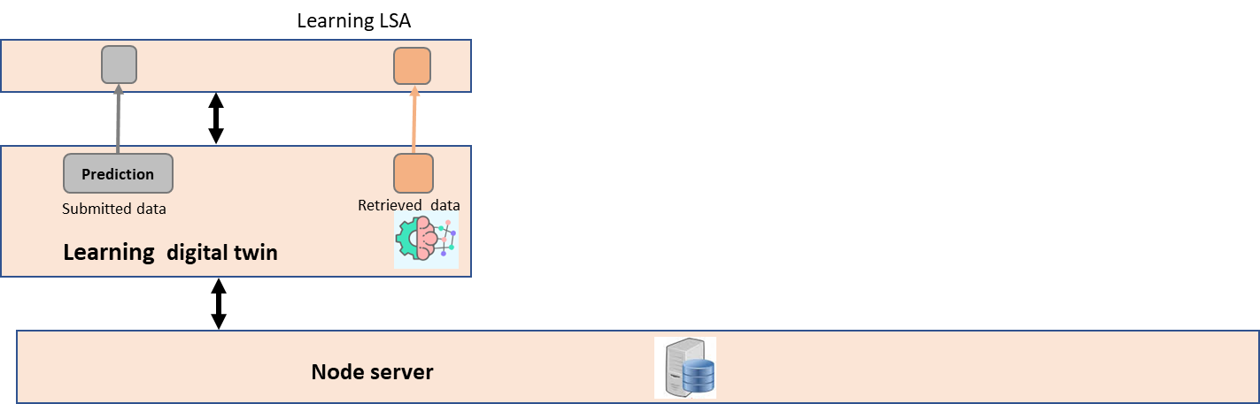
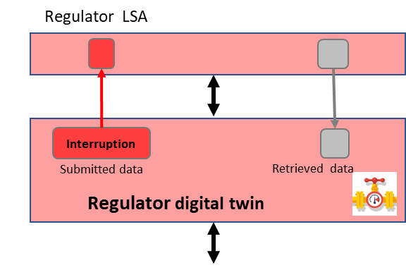
Design of Digital Twins to represent microgrid entities
Designing and implementing Digital Twins which interact though the virtual environment.
Prosumer twins: exchange energy
Supervisor twins
PhD dissertation, June 2025

Slide 12
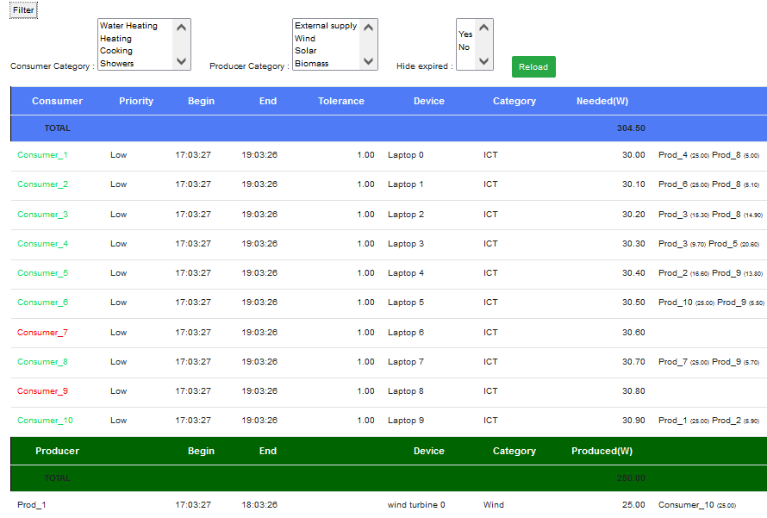





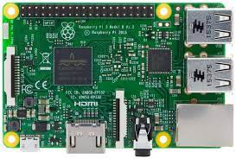



Architecture and implementation
Web Application
web page
Test simulator
Client applications
Request
Request
Neighbor node 1
HTTP/JSON
Coordination platform service
Response
Response
Coordination platform service
TCP/IP
RESTFUL server
Neighbor node 2
Coordination platform service
Digital twin (agents)
Digital twin
Digital twin
Digital twin
Reading /
writing
…
« Derivative SAPERE »
kernel
LSA
LSA
LSA
Neighbor node n
Coordination laws
Coordination platform service
Tuples space
PhD dissertation, June 2025

Slide 13
Agenda
Context and motivations
State of the art and research questions
Coordination Model and Digital Twins
Exchange and regulation of energy among Digital Twins
Using auto-composition to generate a contract of energy
Using auto-composition to manage peak shaving
Experimentation with real data (from a living lab)
Gossip coordination mechanism for decentralised learning
Integration of Social acceptance
Conclusion
PhD dissertation, June 2025

Slide 14

Using auto-composition to generate a contract of energy
Consumer twin
LSA
Tuple space
Request
Contract
Coordination laws
Bonding
Spreading
Decay
Offer
LSA
Confirmation
Producer twin
Data exchanged:
Request
Offer
Contract
Confirmation
PhD dissertation, June 2025

Slide 15
Step 1 : sending of energy demands
Consumer twin
Request activation
LSA
Tuple space
Request
Coordination laws
Bonding
Spreading
Decay
LSA
Request
Producer twin
PhD dissertation, June 2025

Slide 16
Step 2 : sending of supply offers
Consumer twin
Offer
LSA
Tuple space
Request
Coordination laws
Bonding
Spreading
Decay
Offer
LSA
Request
Offer
Offer generation
Producer twin
PhD dissertation, June 2025

Slide 17
Step 3 : sending of a new contract to be validated
Consumer twin
Creation of a new contract to be validated
Offer
LSA
Tuple space
Request
New contract
Coordination laws
Bonding
Spreading
Decay
New contract
LSA
Request
Offer
New contract
Producer twin
PhD dissertation, June 2025

Slide 18
Step 4 : sending of contract approvals
Consumer twin
Status update
New contract
Updated contract
Producer confirmation
LSA
Tuple space
New contract
Request
Updated contract
Coordination laws
Bonding
Spreading
Decay
Producer confirmation
LSA
Request
Offer
New contract
Availability check
Producer twin
PhD dissertation, June 2025

Slide 19
Step 5 : contract refresh and validation
Consumer twin
Integration of the last approval
LSA
Tuple space
Request
Validated contract
Coordination laws
Bonding
Spreading
Decay
LSA
Request
Offer
Validated contract
Producer twin
PhD dissertation, June 2025

Slide 20
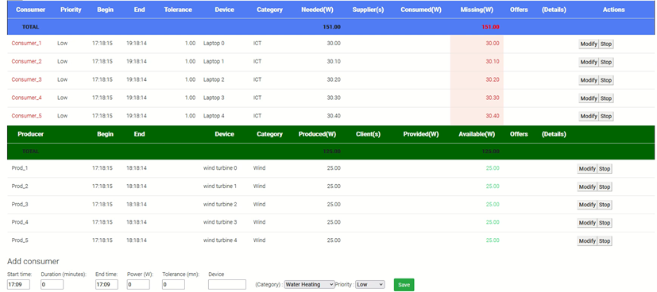
Contract generation
PhD dissertation, June 2025

Slide 21


Contract generation
PhD dissertation, June 2025

Slide 22
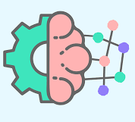

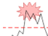

Using auto-composition to manage peak shaving
Learning twin
Regulator twin
1: submission of a prediction with a threshold exceeded
(2)
(1)
(3)
LSA
LSA
2: selection of prosumers to be stopped
Prediction
Prosumer stop
Tuple space
Replanning
3: submission of replanning orders
4: postponement of activity
LSA
(5)
5: submission of prosumer stop event
Prosumer
twin
(4)
PhD dissertation, June 2025

Slide 23
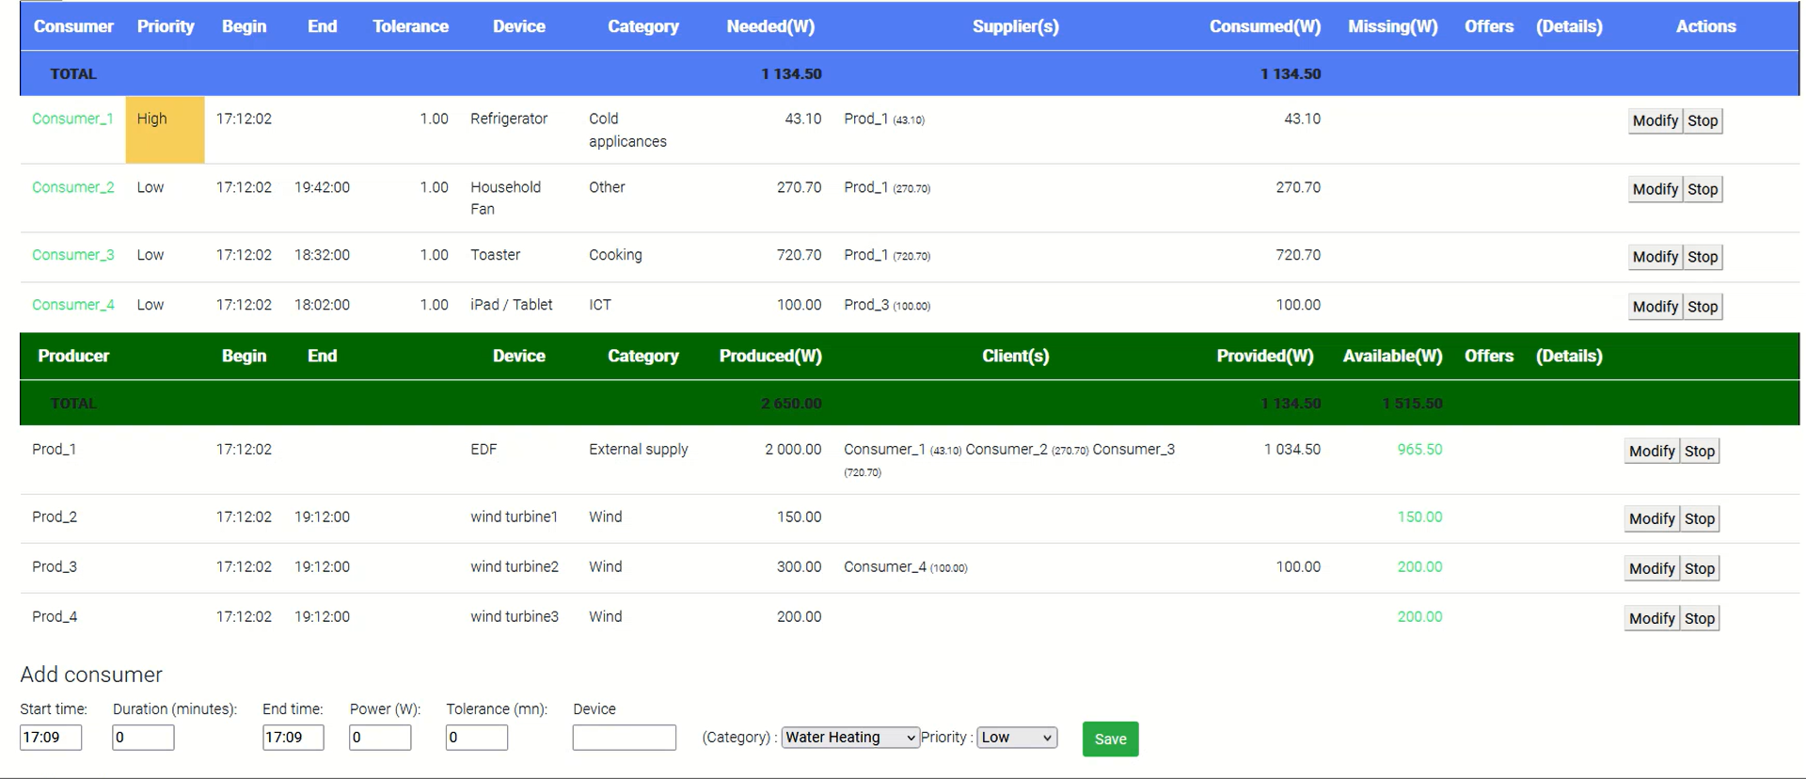
Using auto-composition to manage peak shaving
PhD dissertation, June 2025

Slide 24
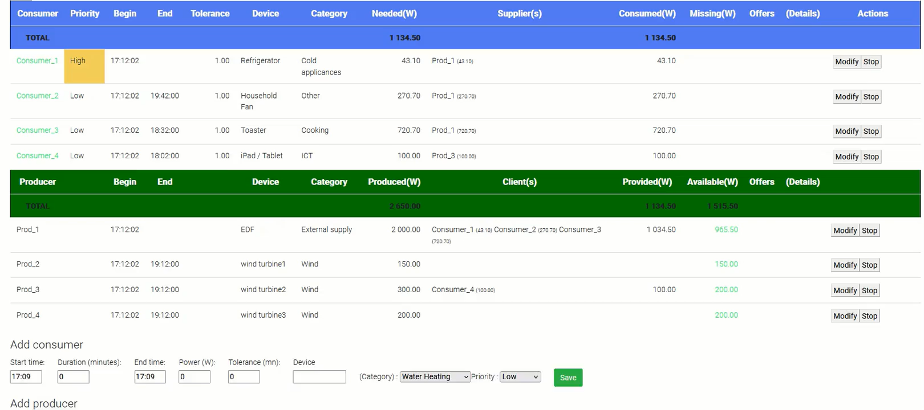
Using auto-composition to manage peak shaving
PhD dissertation, June 2025

Slide 25
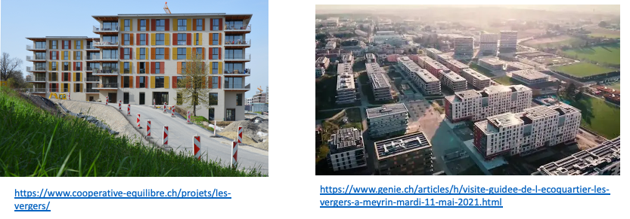
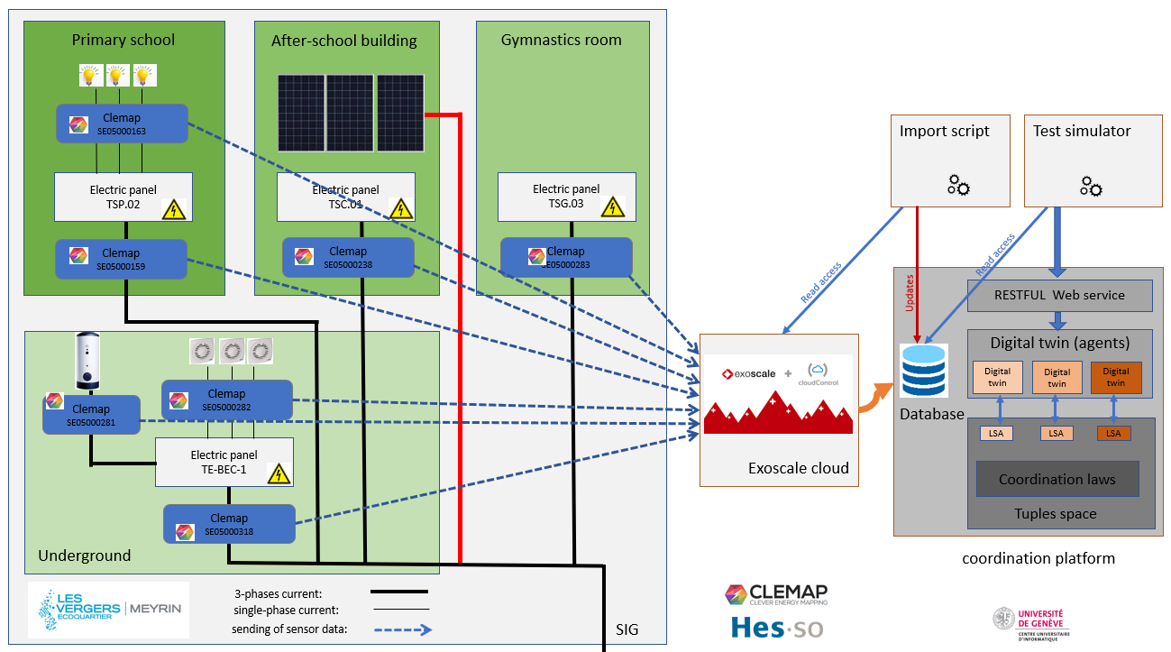
Retrieving real data from the living lab
Power measurements by smart-meters.
Storage of power history.
PhD dissertation, June 2025

Slide 26
Agenda
Context and motivations
State of the art and research questions
Coordination Model and Digital Twins
Exchange and regulation of energy among Digital Twins
Gossip coordination mechanism for decentralised learning
Gossip coordination mechanism: zoom on aggregation
Gossip coordination mechanism: zoom on spreading
Gossip Federated Learning
Gossip Ensemble Learning
Integration of Social acceptance
Conclusion
PhD dissertation, June 2025

Slide 27
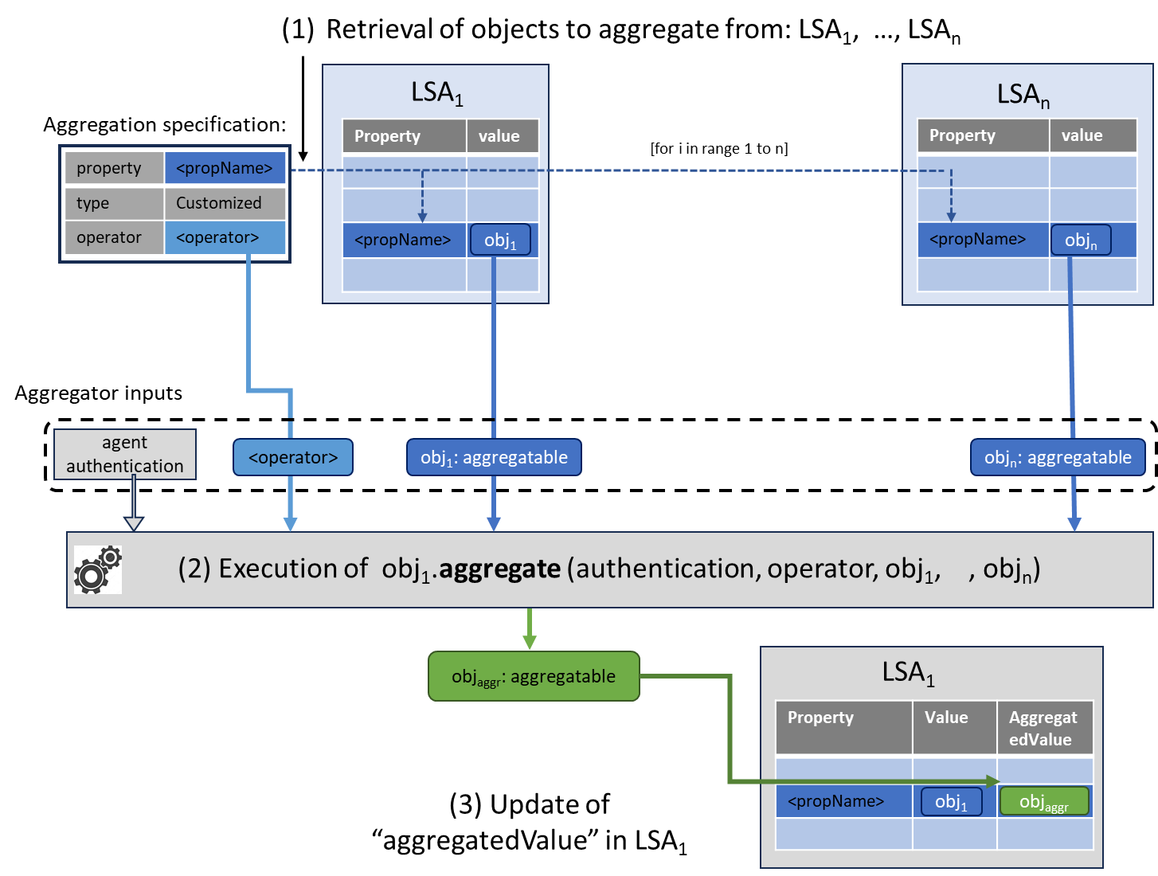
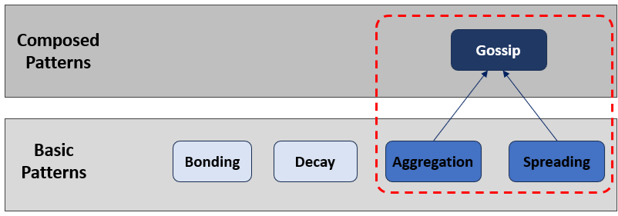
Gossip coordination mechanism: zoom on aggregation
Implementation of aggregation
J. L. Fernandez-Marquez et al. “Description and composition of bio-inspired design patterns: a complete overview”, in: Natural Computing (2012)
PhD dissertation, June 2025

Slide 28
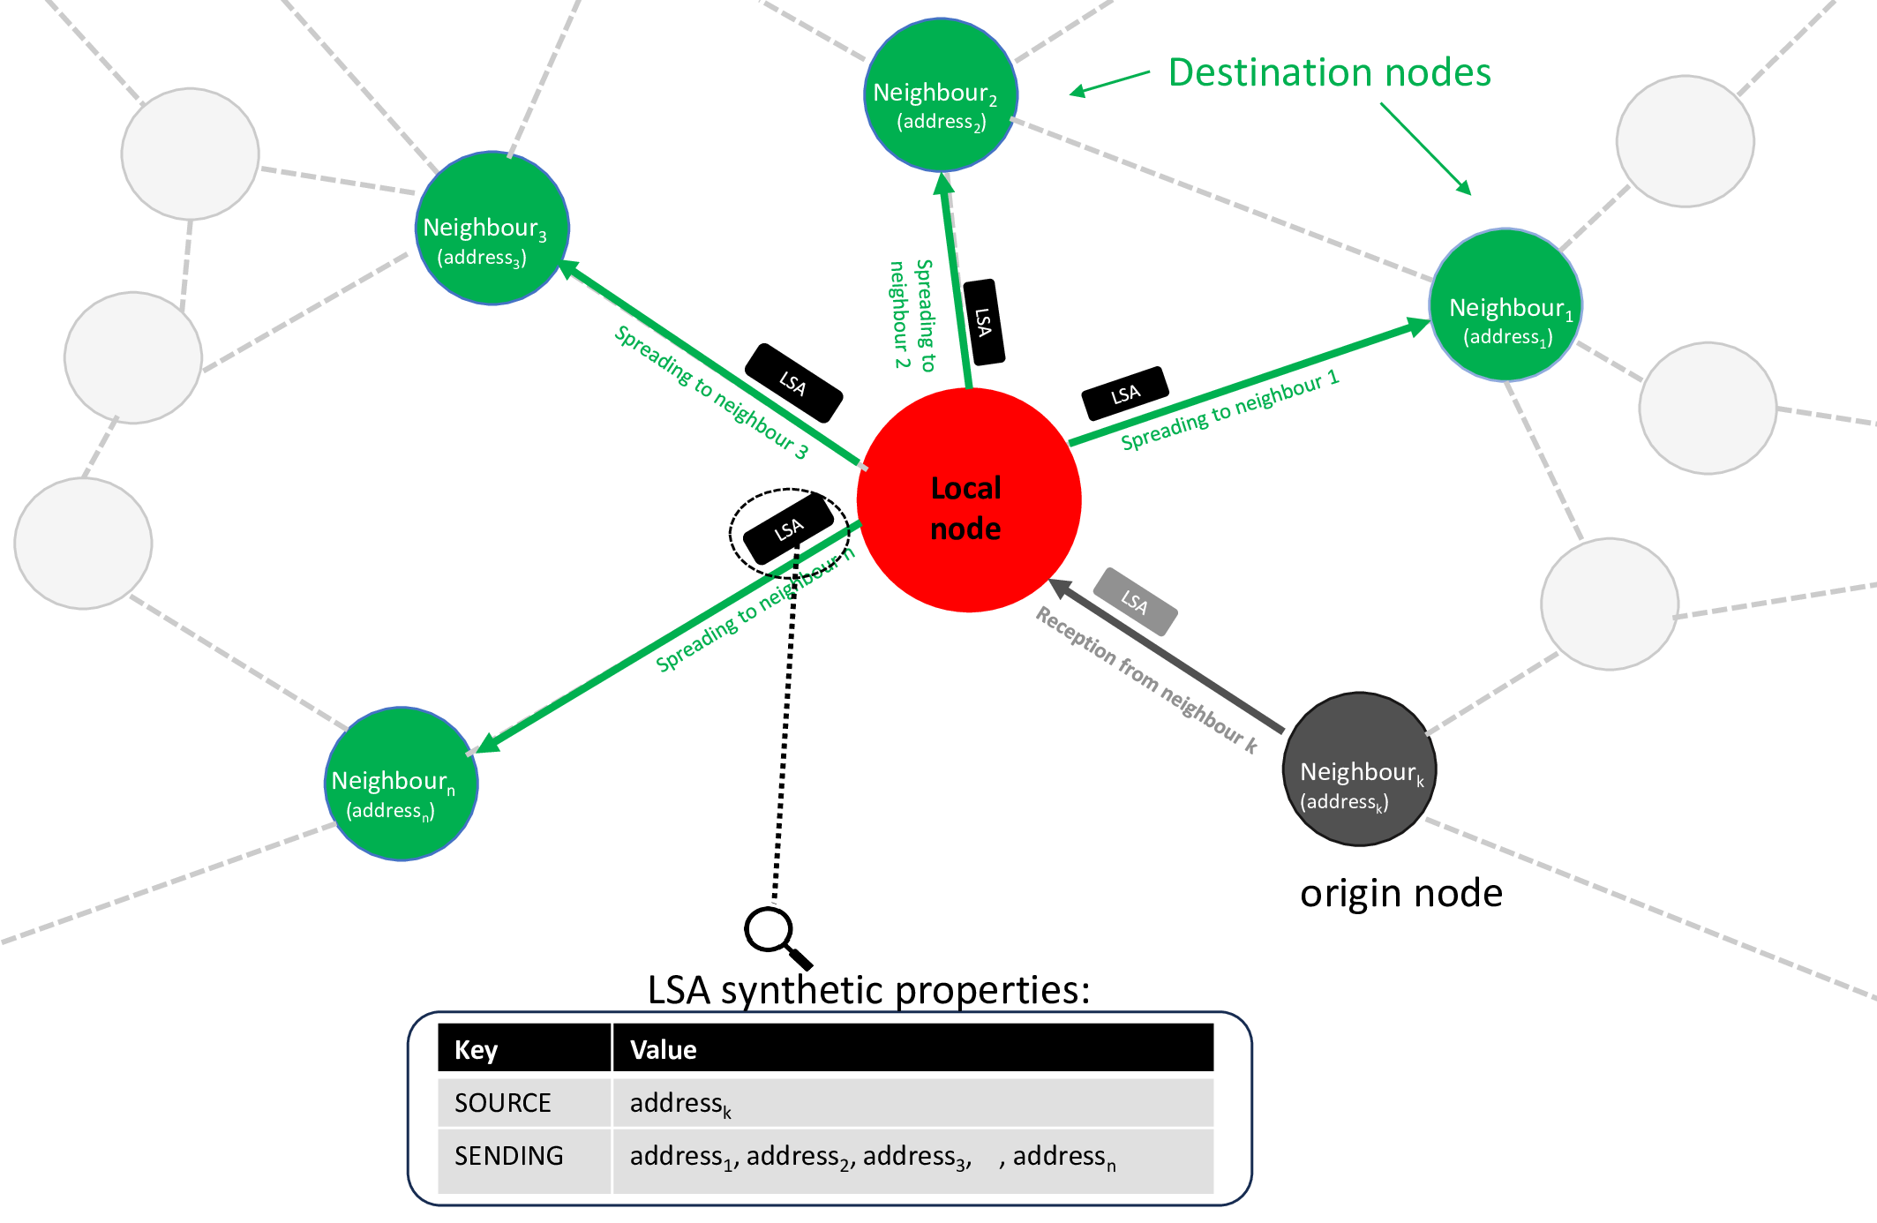
Gossip coordination mechanism: zoom on spreading
Implementation of spreading
J. L. Fernandez-Marquez et al. “Description and composition of bio-inspired design patterns: a complete overview”, in: Natural Computing (2012)
PhD dissertation, June 2025

Slide 29
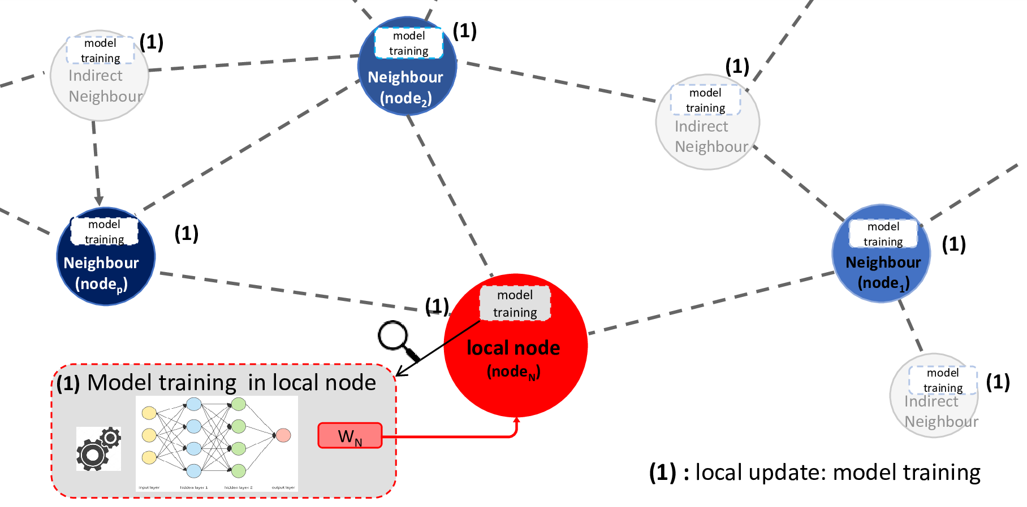
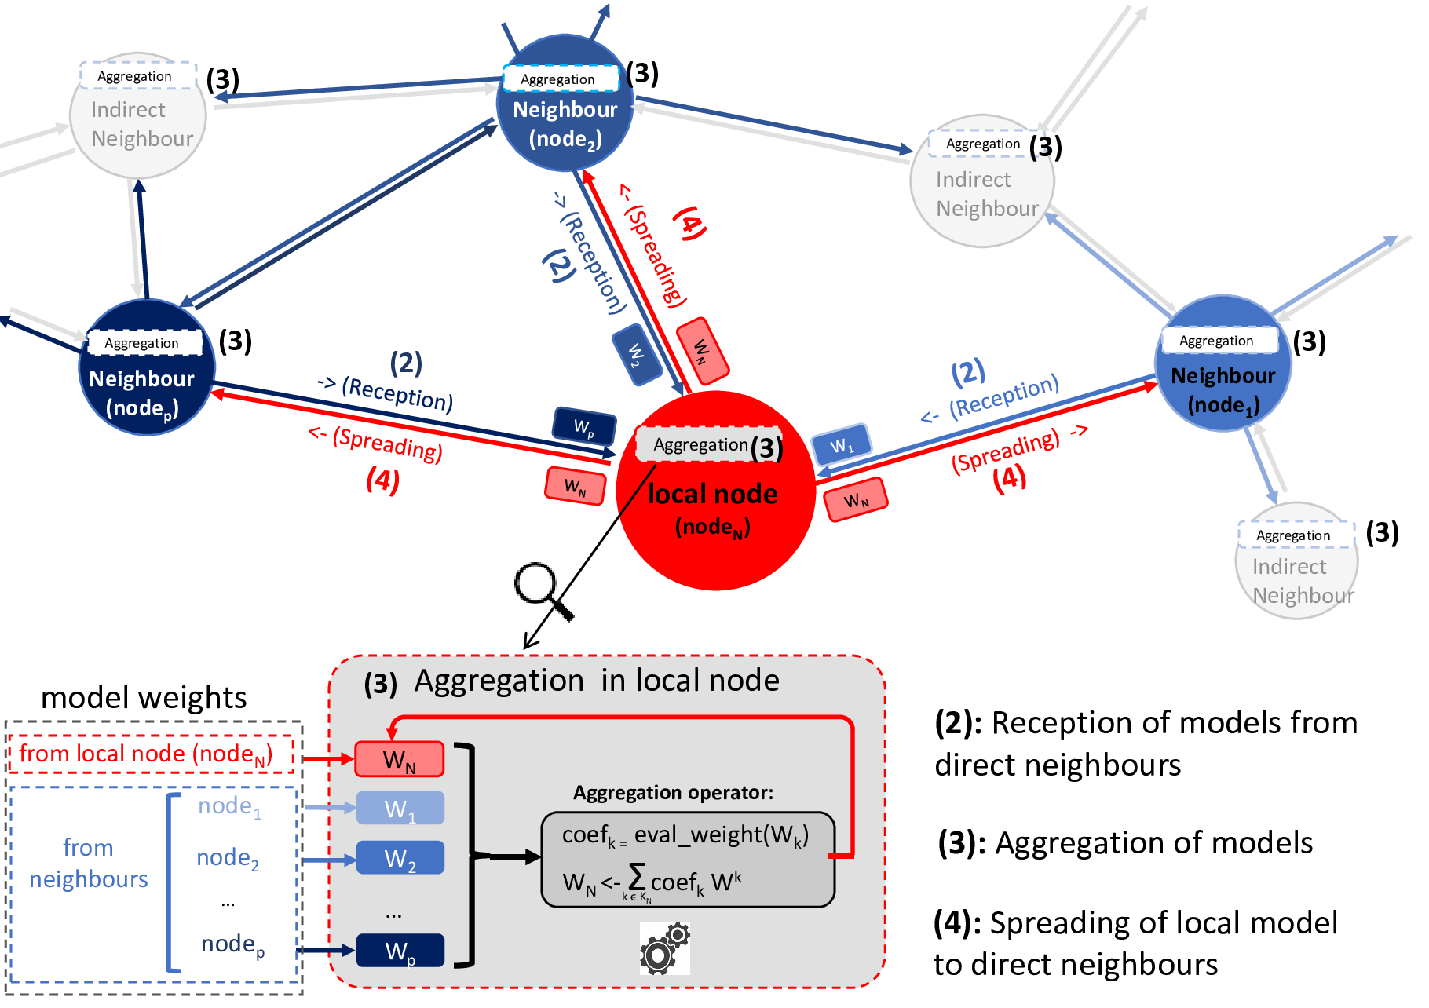
Gossip Federated Learning
Applying the “gossip” mechanism on learning models.
Training models:
Every 1 to 20 minutes depending on the classifier used
Sharing models:
Every 1 to 5 minutes depending on the classifier used
Constraint : same classifier for all nodes
PhD dissertation, June 2025

Slide 30
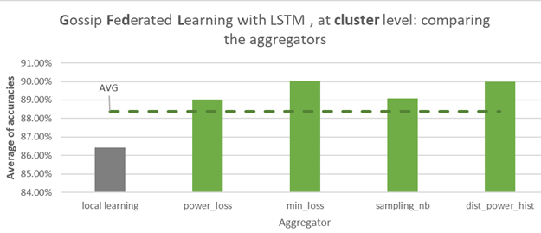
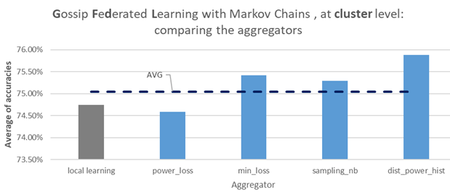
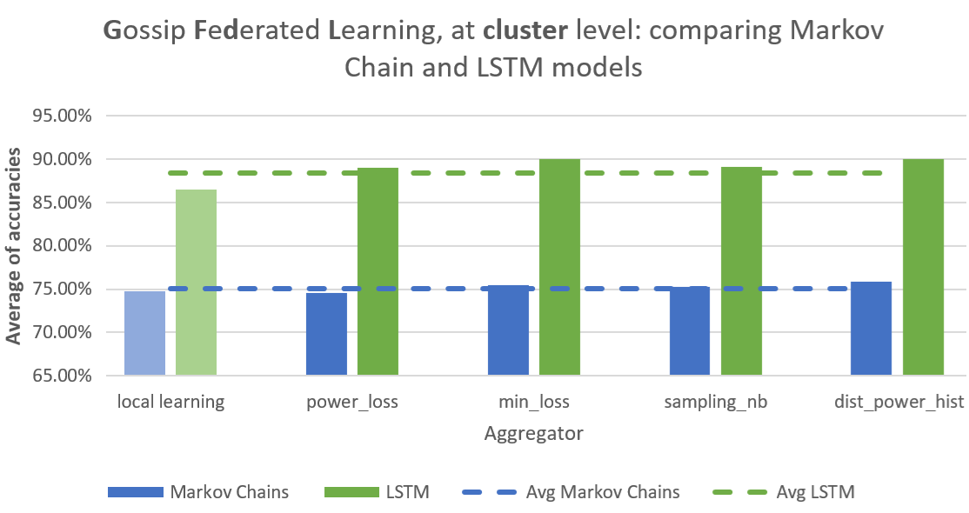
Assessing Gossip Federated Learning
Experimentation with 2 different learning models: Markov Chains and LSTM.
Gossip Fed. Learning: Comparison of 5 aggregators:
Use of LSTM model:
‘min loss’ outperforms
Use of MC model:
‘Power profile’ outperforms
Comparison MC/LSTM
LSTM outperforms
Accuracy means obtains with 43 730 (*) predictions generated at different days, during 3-hour slots.
(*) : 25 896 generated with Markov Chains and 17 834 with LSTM
Volatility of aggregator rankings
Accuracy sensitives to the different parameters (classifier used, hyperparameters, perimeter, ....).
PhD dissertation, June 2025

Slide 31
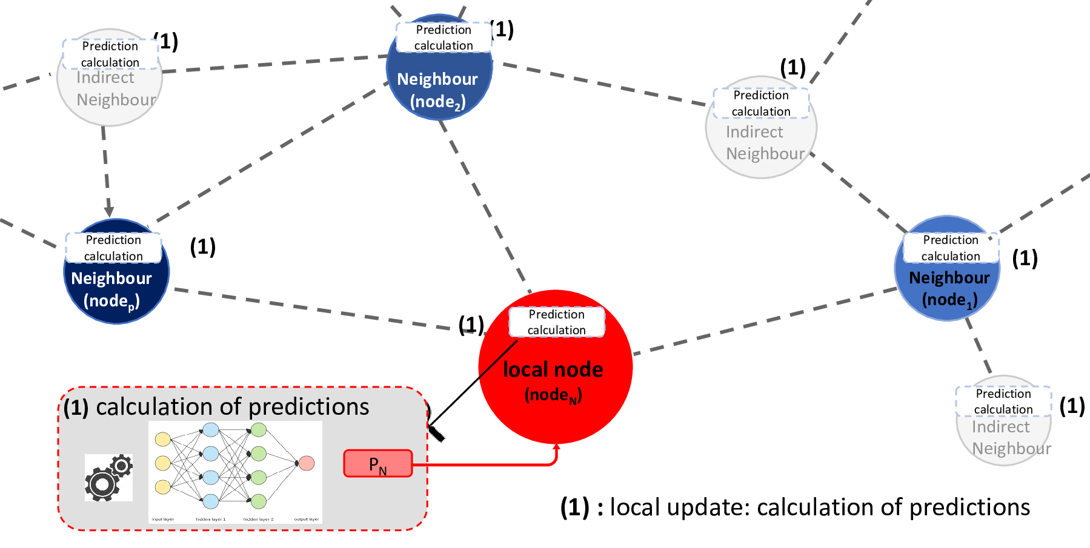
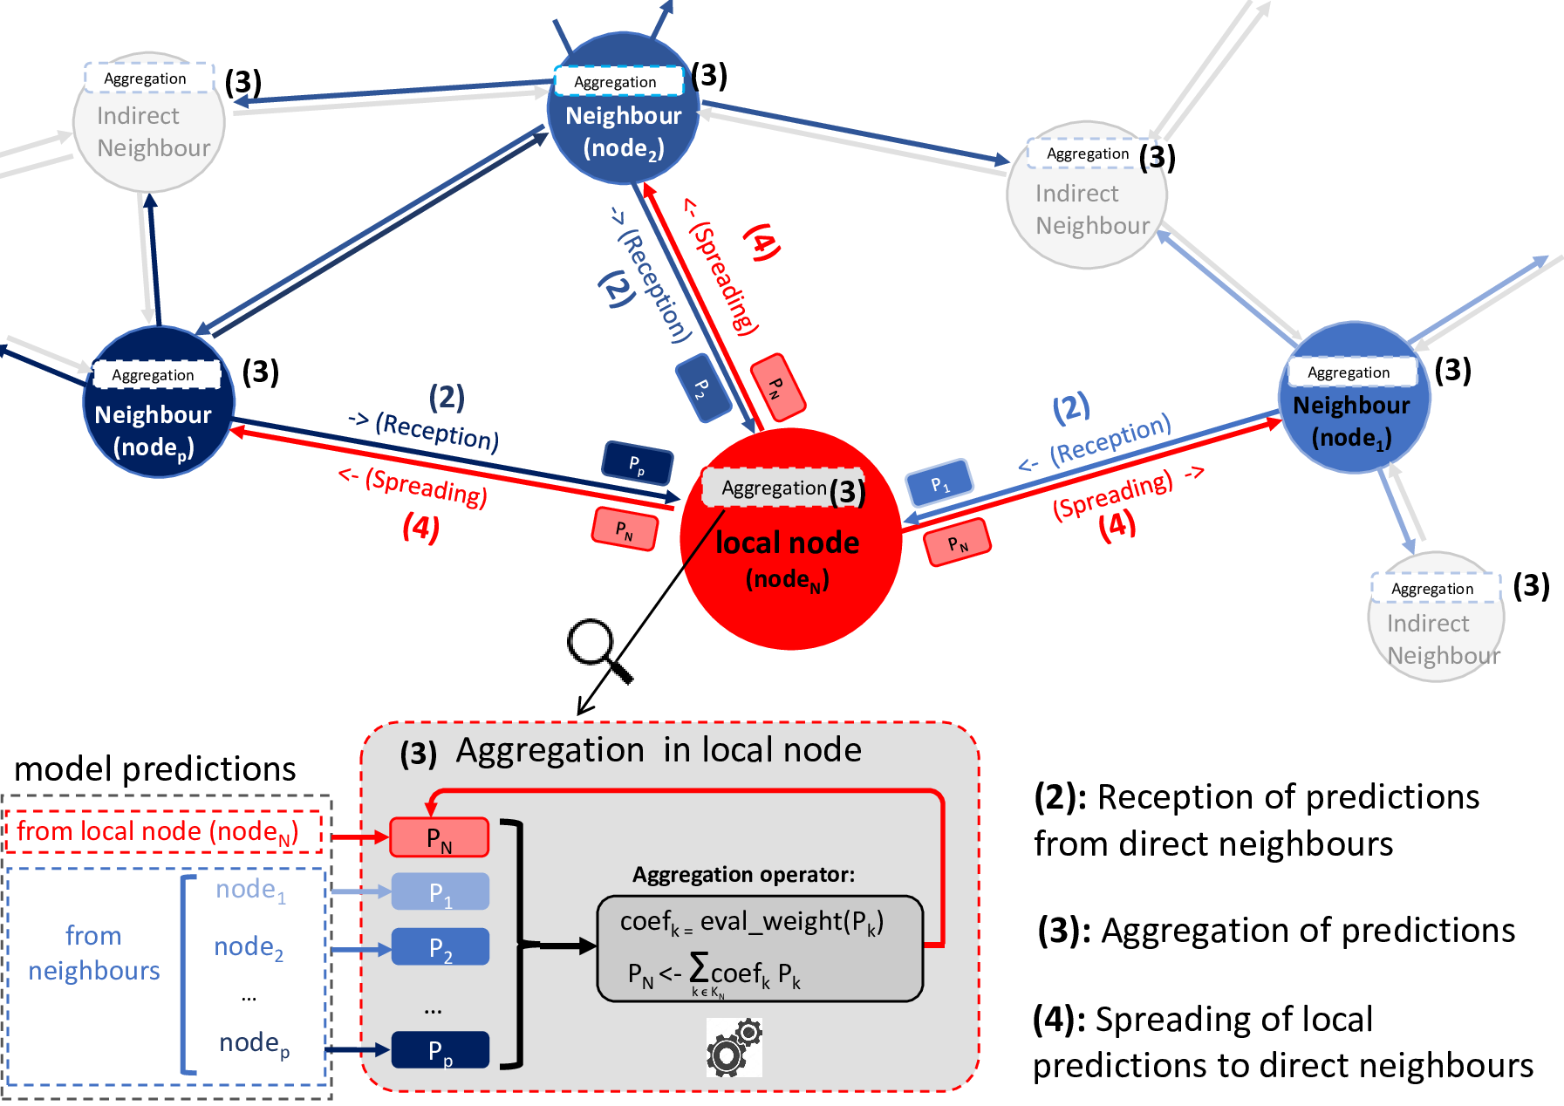
Gossip Ensemble Learning
Applying the “gossip” mechanism to distribute and combine predictions.
Computing predictions:
Every minute
Sharing predictions:
Every minute
No constraint on node classifiers
PhD dissertation, June 2025

Slide 32
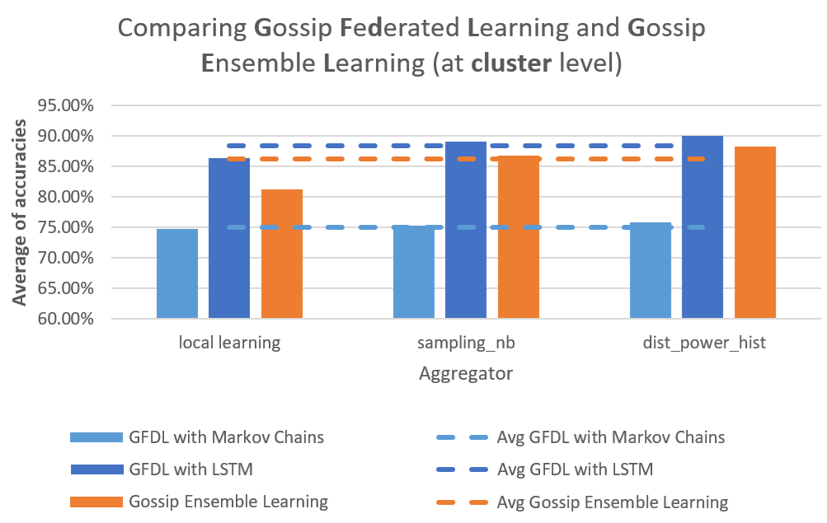
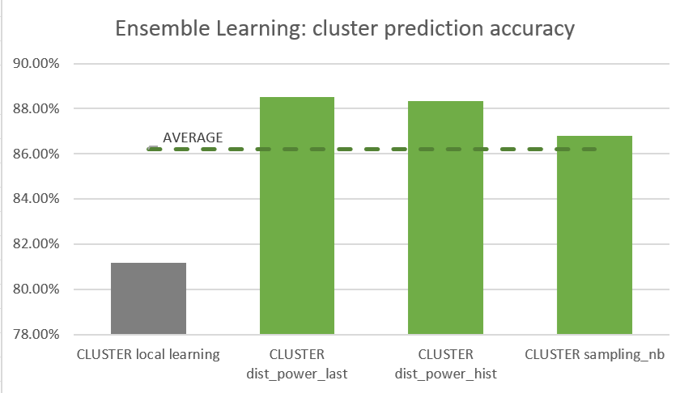
Assessing Gossip Ensemble Learning
Experimentation with a mix of MC and LSTM classifiers
Comparison of 3 aggregators:
Comparison with Gossip Federated Learning:
Accuracy means obtains with 115 950 predictions generated at different days, during 3-hour slots.
‘dist_power_last’ aggregator outperforms
Gossip Ensemble Learning just behind Gossip Federated Learning
PhD dissertation, June 2025

Slide 33
Agenda
Context and motivations
State of the art and research questions
Coordination Model and Digital Twins
Exchange and regulation of energy among Digital Twins
Gossip coordination mechanism for decentralised learning
Integration of Social acceptance by design
Dynamic pricing to address tragedy of the common
Reward management to address ‘Free-rider’ behaviours
Energy storage to address general shortage
Conclusion
PhD dissertation, June 2025

Slide 34
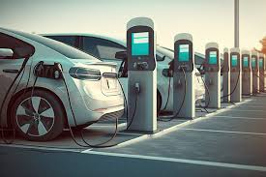


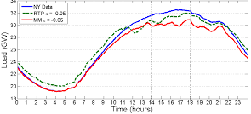

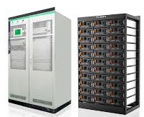
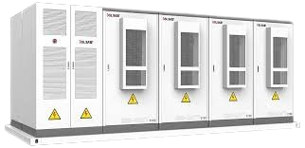
Integration of social acceptance by design
Use of HES-SO Valais’s research (study on social acceptance of microgrid applications)
Implementation of the “prosumer” twin (represents a microgrid community member)
Implementation of scenarios reproducing social dimension problems:
Tragedy of the common
Free-rider behaviours
General shortages
Implementation of new Digital Twin algorithms:
Dynamic pricing to address Tragedy of the common
Reward management to address ‘Free-rider’ behaviours
Energy storage to address general shortages
Assessments of the new algorithms with the 3 scenarios
PhD dissertation, June 2025

Slide 35
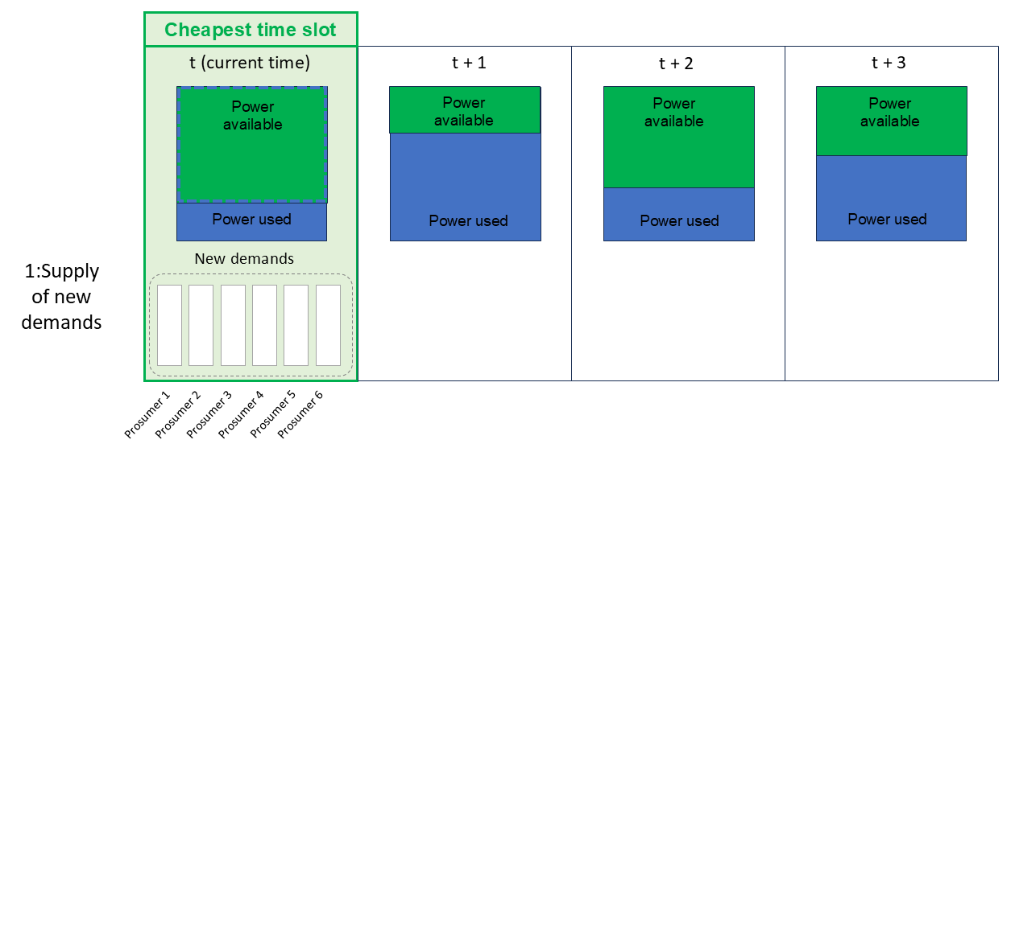
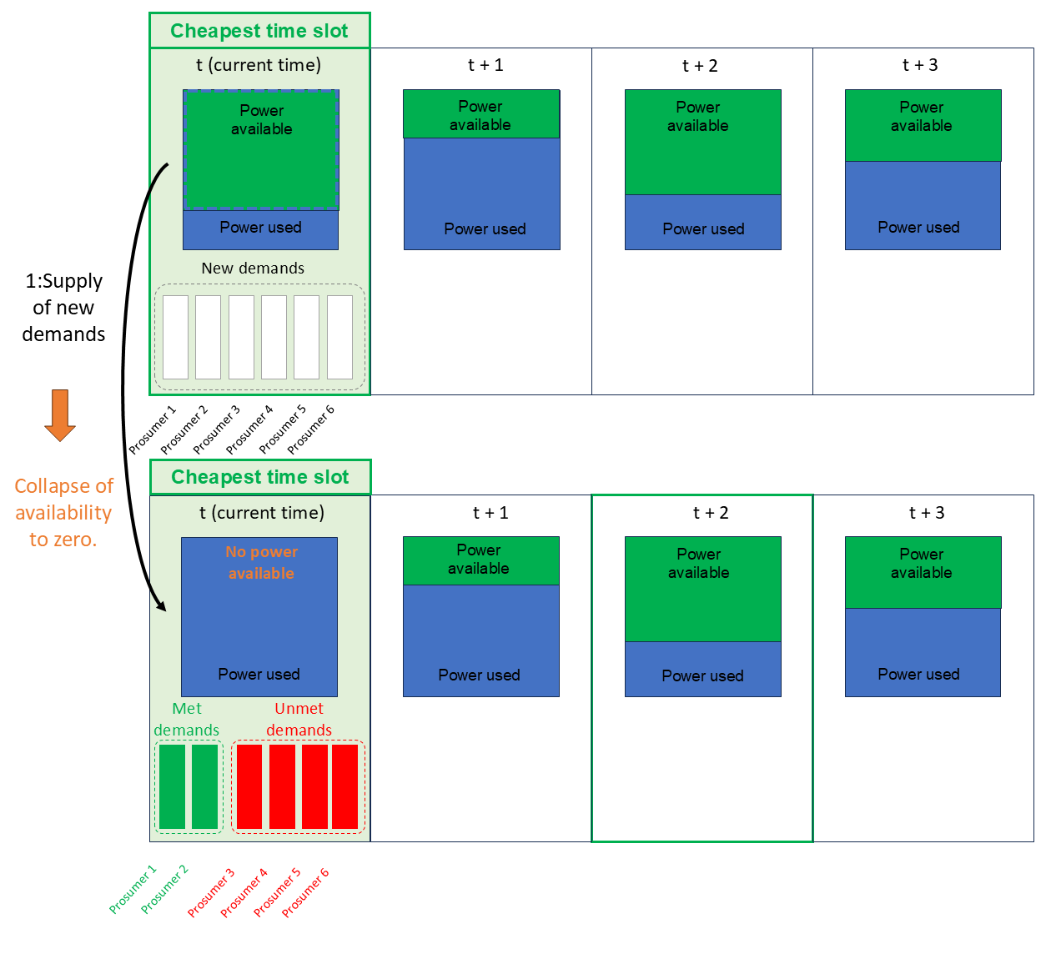
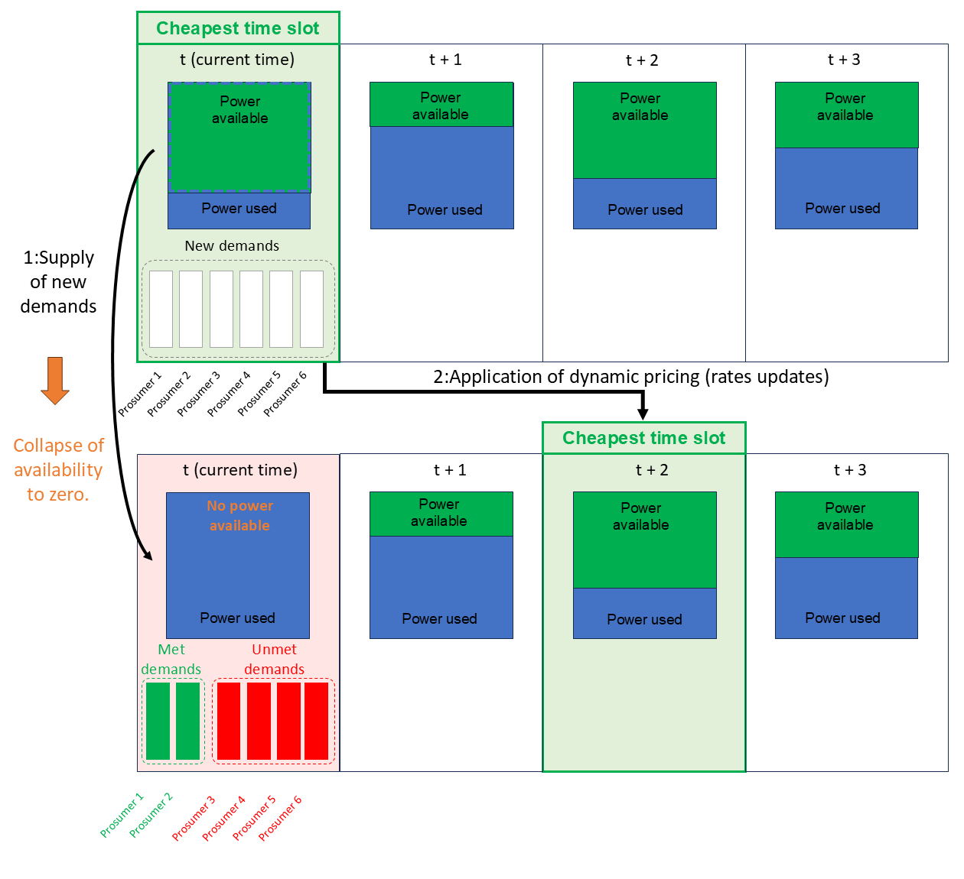
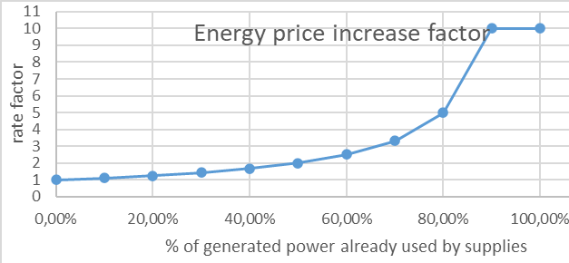

Dynamic pricing to address tragedy of the common
Application of dynamic pricing
Deferral of electricity demand following rate increases
PhD dissertation, June 2025

Slide 36






Reward management to address ‘Free-rider’ behaviours
-460 pts
+150 pts
Award/penalty attribution based on:
Supply
Contract
energy contribution
equity in energy distribution
efforts to limit consumption
+220 pts
“peer to peer” supply
award/penalty attribution
PhD dissertation, June 2025

Slide 37


Reward management to address ‘Free-rider’ behaviours
Exclusion in energy offers
Integration of credit scores into KWH rates
Price / KWH
1 free-rider prosumer
2 altruistic prosumers
PhD dissertation, June 2025

Slide 38

Energy storage to address general shortages
“common” storage managed by the “storage” twin
Prosumer Twins
Producer
(energy surplus)
“Storage” twin
Consumer
(energy need)
PhD dissertation, June 2025

Slide 39


Energy storage to address general shortages
Using stored energy during a power cut from an external supplier
Private storage
Common storage
Capacity
(WH)
Outage time slot
Outage time slot
10
20
70
PhD dissertation, June 2025

Slide 40
Agenda
Context and motivations
State of the art and research questions
Coordination Model and Digital Twins
Exchange and regulation of energy among Digital Twins
Gossip coordination mechanism for decentralised learning
Integration of Social acceptance
Conclusion
PhD dissertation, June 2025
40

Slide 41










Conclusion: contributions and impacts
Contribution | Economic | Social | Technological | Environmental
1: Coordination Model and Digital Twins for exchanging energy in smart grids (RQ 1 + RQ 2 + RQ 5)
Save money and energy
(local transactions)
Integrate renewable energies
Avoid peaks
2:Gossip coordination mechanism for decentralised Learning (RQ 3)
Reduce communication overhead
Ensure data privacy
Increase learning accuracy
3: Integration of social acceptance by design (RQ 4)
Improve welfare and involvement
P | E | S | T | E | L
PhD dissertation, June 2025

Slide 42






Conclusion: limitations and future works
Limitations
Smart meter do not receive decisions from Digital Twins
Some algorithms are missing:
negotiation between prosumers
interactions with real world entities (DSO, TSO, …)
heuristics for assessing prosumer well-being
Future works
Test on a larger scale
Deploy Several Microgrids (hierarchies)
Install and use actuators in Smart meters
2024 : Swiss legislation in favour of dynamic pricing and energy communities
PhD dissertation, June 2025

Slide 43


Publications
 | Design of a coordination model and Digital Twins for exchanging energy in smart grids | Gossip mechanisms for decentralised Learning
Full paper reference | Coordination Model and Digital Twins for Managing Energy Consumption and Production in a Smart Grid P Glass, G Di Marzo Serugendo https://www.mdpi.com/1996-1073/16/22/7629 | Gossip coordination mechanisms for Decentralised Learning P Glass, G Di Marzo Serugendo https://www.mdpi.com/1996-1073/18/8/2116
I.F./conference A.R. | IF=3.0 (paper) | IF=3.0 (paper)
Contribution to thesis | Developing of a new coordination, which derives from SAPERE. Implementation of the digital twins that represent the microgrid entities. | Integration of Gossip Federated Learning and Gossip Ensemble Learning using the coordination model.
Scientific contribution type | Developing a new model , Deriving superior algorithms | Deriving superior algorithms
author Contributions | Design and implementation of the algorithms, scenarios and needed databases. | Implementation of the algorithms, scenarios and needed databases.
Integration of social acceptance by design
Fragniere, Emmanuel and Sandoz, Sarah and Abdenadher, Nabil and Moussa, Mohamad and Di Marzo Serugendo, Giovanna and Glass, Philippe: Improving the Social Acceptability of Microgrids (IEEE Renewable Energy and Sustainable E-Mobility Conference (RESEM), May2023 https://ieeexplore.ieee.org/abstract/document/10236324
AR=30% (conference)
Integration of social acceptance by design in the Digital Twins behaviours.
Human factors research, Deriving superior algorithms
Participation in studies/surveys
https://scholar.google.com/citations?hl=fr&user=oh_BXHgAAAAJ
https://orcid.org/0000-0002-6258-0034
PhD dissertation, June 2025

Slide 44

Questions
PhD dissertation, June 2025

Slide 45

LSA synthetic properties
PhD dissertation, June 2025

Slide 46

Bonding coordination law
PhD dissertation, June 2025

Slide 47

LSA properties
PhD dissertation, June 2025

Slide 48






Coordination Platform tuning in a 4-nodes configuration
“Chain” configuration (1 or 2 neighbors by node)
PhD dissertation, June 2025

Slide 49

Principle of dynamic adaptation
PhD dissertation, June 2025

Slide 50

Steps of contract generation
PhD dissertation, June 2025

Slide 51

Dealing with fluctuating energy demands
Consideration of the fluctuation in demands
Use of a margin in a contract to absorb the power variation
Use of a « transition contract » when the variation is more important.
Transition contract to meet a growing demand for electricity ( + 300 Watts)
PhD dissertation, June 2025

Slide 52

Processing an urgent request
PhD dissertation, June 2025

Slide 53




Preparation of a light version for Raspberry pi-3
Definition of the target environment
Replacement of spring-boot server by a lighter server
Deactivation of functionalities not used (prediction)
Monitoring of memory consumption (use of Visual VM tool)
Replacement of MariaDB & MongoDB by SQLite3
Building of docker image containing the coordination service jar file
Deployment and tests on Linux environment (UNIGE VM)
PhD dissertation, June 2025

Slide 54

‘Centralized’ Federated Learning
PhD dissertation, June 2025
54

Slide 55

Aggregation of 3 properties
PhD dissertation, June 2025

Slide 56

Implementations of aggregation
PhD dissertation, June 2025

Slide 57

The different aggregation functions used
a model which contains more samples in training data should be more accurate.
a model from a node which contains a more similar power profile should be more accurate.
how the node model prediction is similar to the validation values (use the validation data set).
the metamodel composed with the different received models does not perform that the single model that minimises the loss value.
PhD dissertation, June 2025

Slide 58

Aggregation of compacted Learning models
PhD dissertation, June 2025

Slide 59



Learning model: use of Markov chains
State of the node
=> 6 variables: wattage demanded, produced, consumed, provided, missing and available
Definition of Markov states
Cutting of the variable space (time slots)
Recording the number of observations
Transition matrix
PhD dissertation, June 2025
59

Slide 60

Learning model: integration of LSTM
PhD dissertation, June 2025
60

Slide 61

Learning model: integration of a new model (XXX)
PhD dissertation, June 2025
61

Slide 62







Object protection
Digital twin
(Authenticated agent)
Request for access to the sensitive object
?
wrapper object (manages the access)
KO
Authentication
verification
Access denied
OK
Request for access to the sensitive object
?
Sensitive object
Complete
data
No access
Calculation of visibility
on information
Access denied
Partial or total access
Restricted data
PhD dissertation, June 2025

Slide 63

Object protection: energy contract
PhD dissertation, June 2025

Slide 64


Tragedy of the common: experimentation
Initial version
Application of dynamic pricing:
PhD dissertation, June 2025

Slide 65
Dissemination
Presentations:
Poster sessions
Face-to-face Lasagne meetings
Data-science day, Geneva, September 15, 2022
PhD student day, Geneva, September 29, 2023
Stockholm, September 27, 2022
Sierre, June 8, 2023
Stockholm, September 3-4, 2024
PhD Thesis yearly presentations
Conference
Geneva, February 6-7, 2023
Geneva, February 15-16, 2024
Geneva, February 13-14, 2025
Session on Digital Twins and AI semantic, Geneva, November 7, 2024
Service:
Preparation of Project challenge for Energy data Hack days 2023, Brugg-Windisch.
Project peer reviews with ERANET sessions, June 2024.
Outreach and Community Engagement:
LASAGNE Dissemination event with DSO, R&D partners, industrial partners, General public:
May 2025: KTH, Stockholm (Energy communities - the new energy landscape)
September 2025: Val d’Anniviers
PhD dissertation, June 2025

